Slide 1
Incident Response –Roles, and Responsibilities

Slide 2
Incident Response
Event: any observable occurrence in a system or network.
Adverse events: events with a negative consequence.
Incident: set of one or more security events or conditions that requires action and closure in order to maintain an acceptable risk profile.

Slide 3
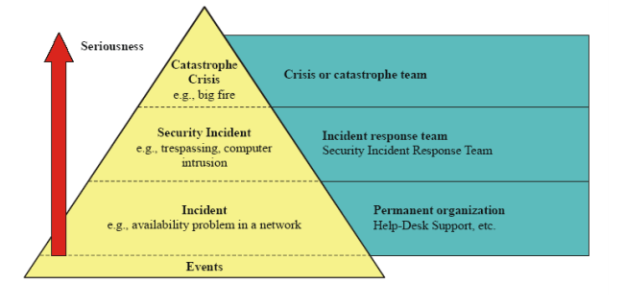
Pyramid of events

Slide 4
Introduction to Incident Handling and Response
Incident response capability - rapidly detecting incidents, minimizing loss and destruction, mitigating the weaknesses that were exploited and restoring IT services.

Slide 5
Types of information security incidents
Peripheral devices such as external/ removable media
Attrition
Website or web based application
Email message or attachment
Improper usage of an organization’s acceptable usage policies by an authorized user
Loss or theft of equipment
Other factors

Slide 6
Incidents - Classification
Malicious code
Network reconnaissance
Unauthorized access
Inappropriate usage
Multiple component

Slide 7
Impact of information security incidents
Functional impact (current and likely future negative impact to business functions)
Information impact (effect on the confidentiality, integrity, and availability of the organization’s information)
Recoverability from the incident (time and types of resources that must be spent on recovering from the incident)

Slide 8
Need for incident response
to respond quickly and effectively when security breaches occur.
to be able to use information gained during incident handling to better prepare for handling future incidents.
to provide stronger protection for systems and data.
to help deal properly with legal issues that may arise during incidents.
to comply with law, regulations, and policy directing a coordinated, effective defense against information.

Slide 9
Goals of incident response
formal, focused, and coordinated approach to responding to incidents.
adhere to organization’s mission, size, structure, and functions.
formulate policy, plan, and procedure creation to counter adverse events.
to provide stronger protection for systems and data.
to minimize loss or theft of information and disruption of services.
to respond quickly and effectively when security breaches occur.

Slide 10
Handling Different Types of Information Security Incidents

Slide 11
Handling Incidents
Incident handling phases:
- Preparation: establishing and training an incident response team, and acquiring the necessary tools and resources.
- Detection and analysis: detecting security breaches and alerting organization during any imminent attack.
- Containment: mitigating the impact of the incident by containing
- Eradication and recovery: carrying out detection and analysis cycle to eradicate incident and ultimately initiate recovery.
- Post-incident activity: preparing detailed report of the cause and cost of the incident and future preventive measures against similar attacks.

Slide 12
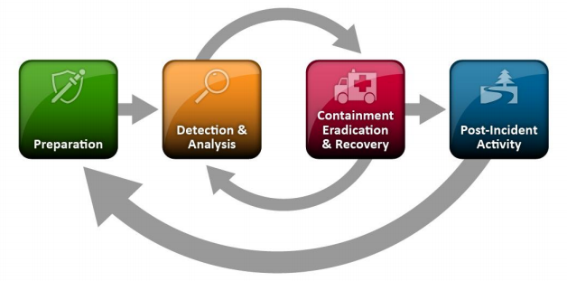
Phases (Life cycle)

Slide 13
Preparation
incident analysis hardware and software to identify an incident.
appropriate incident handling communication means and facilities.
incident analysis resources to identify an incident.
incident mitigation software to identify an incident.
different response strategies to identify incidents through attack vectors, such as external/ removable media, attrition, web, email, impersonation, improper usage by organization’s authorized users, loss or theft of equipment and others that are beyond the scope of the above mentioned.

Slide 14
Incident analysis hardware and software to identify an incident
Digital forensic workstations and/or backup devices
Laptops
Spare workstations, servers, and networking equipment, or the virtualized equivalents
Portable printer
Packet sniffers and protocol analyzers
Digital forensic software
Removable media
Evidence gathering accessories

Slide 15
Appropriate incident handling communication means and facilities
Contact information
On-call information
Incident reporting mechanisms
Issue tracking system
Smartphones
Encryption software
War room
Secure storage facility

Slide 16
Incident analysis resources to identify an incident
Port lists
Documentation
Network diagrams and lists of critical assets
Current baselines
Cryptographic hashes

Slide 17
Incident mitigation software to identify an incident
Access to images

Slide 18
Detection and Analysis (Attack Vectors)
Peripheral devices such as external/ removable media
Attrition
Website or web based application
Email message or attachment
Improper usage of an organization’s acceptable usage policies by an authorized user
Loss or theft of equipment
Other factors

Slide 19
Signs of security incident
Two main types
- Precursors: a sign that an incident may occur in the future.
- Indicator: a sign that an incident may have occurred or may be occurring now

Slide 20
Common signs of security incident
Precursors:
web server log entries that show the usage of a vulnerability scanner.
announcement of a new exploit that targets a vulnerability of the organization’s mail server.
threat from a group stating that it will attack the organization.
Indicators:
network intrusion detection sensor alerts when a buffer overflow attempt occurs against a database server.
antivirus software alerts when it detects that a host is infected with malware.
system administrator sees a file name with unusual characters.
host records an auditing configuration change in its log.
application logs multiple failed login attempts from an unfamiliar remote system.
email administrator sees a large number of bounced emails with suspicious content.
network administrator notices an unusual deviation from typical network traffic flows.

Slide 21
Incident Information
Various Sources:
- Alerts
- Logs
- Network flow
- Publicly available information
- People

Slide 22
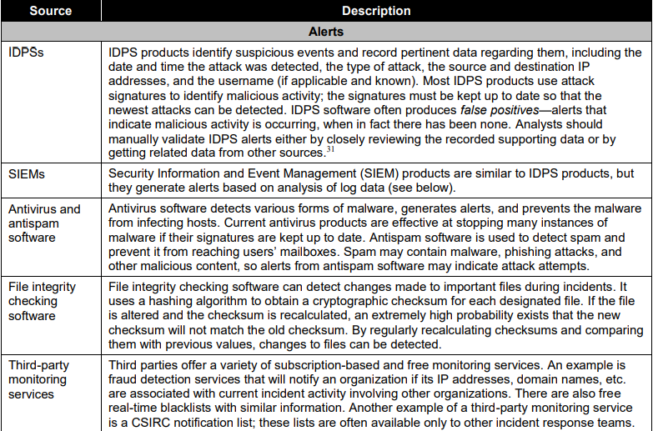
Sources of Precursors and Indicators

Slide 23
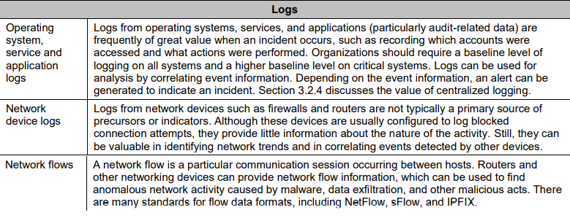
Sources of Precursors and Indicators

Slide 24
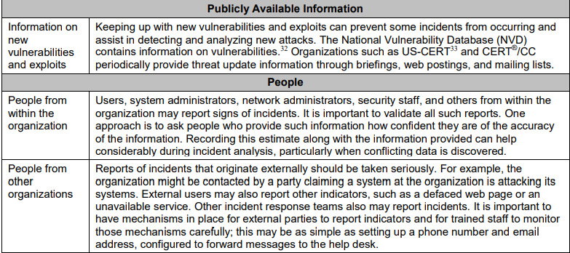
Sources of Precursors and Indicators

Slide 25
Detection and Analysis (Incident Analysis)
Profile Networks and Systems
Understand Normal Behaviours
Create a Log Retention Policy
Perform Event Correlation
Keep All Host Clocks Synchronized
Maintain and Use a Knowledge Base of Information
Use Internet Search Engines for Research
Run Packet Sniffers to Collect Additional Data
Filter the Data
Seek Assistance from Others

Slide 26
Detection and Analysis (Incident Prioritization)
Functional Impact of the Incident
Information Impact of the Incident
Recoverability from the Incident

Slide 27
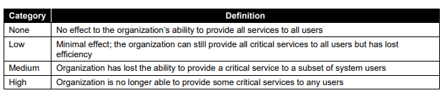
Functional Impact of the Incident

Slide 28
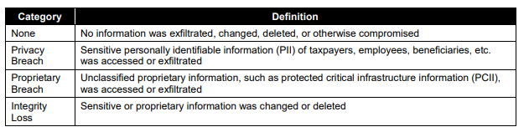
Information Impact of the Incident

Slide 29
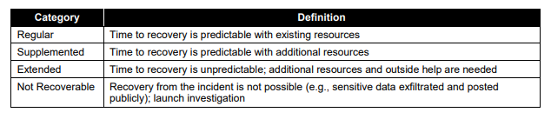
Recoverability from the Incident

Slide 30
Containment, Eradication, and Recovery
Criteria for determining the appropriate strategy include:
- Potential damage to and theft of resources
- Need for evidence preservation
- Service availability (e.g., network connectivity, services provided to external parties)
- Time and resources needed to implement the strategy
- Effectiveness of the strategy (e.g., partial containment, full containment)
- Duration of the solution (e.g., emergency workaround to be removed in four hours, temporary workaround to be removed in two weeks, permanent solution).

Slide 31
Eradication and Recovery
Eradication: to eliminate components of the incident, such as deleting malware and disabling breached user accounts, as well as identifying and mitigating all vulnerabilities that were exploited.
Recovery: administrators restore systems to normal operation, confirm that the systems are functioning normally, and (if applicable) remediate vulnerabilities to prevent similar incidents.

Slide 32
Post-Incident Activity
Learning and improving.
Questions to be answered:
- Exactly what happened, and at what times?
- How well did staff and management perform in dealing with the incident? Were the documented procedures followed? Were they adequate?
- What information was needed sooner?
- Were any steps or actions taken that might have inhibited the recovery?
- What would the staff and management do differently the next time a similar incident occurs?
- How could information sharing with other organizations have been improved?
- What corrective actions can prevent similar incidents in the future? - What precursors or indicators should be watched for in the future to detect similar incidents?

Slide 33
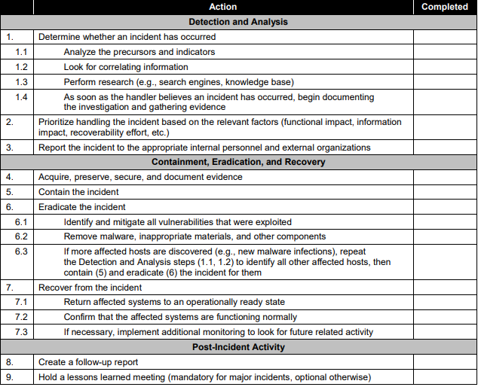
Incident Handling Checklist

Slide 34
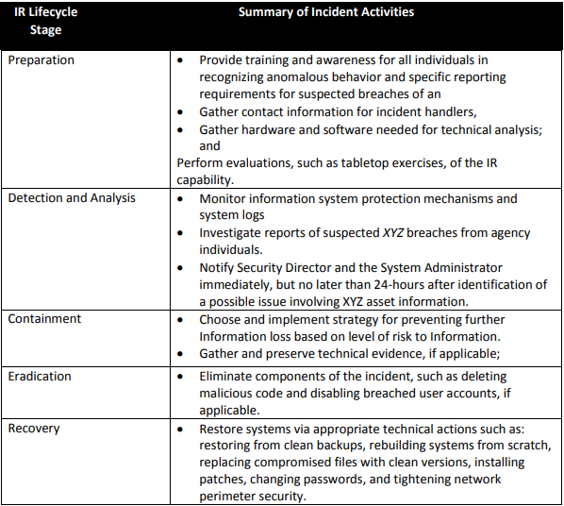
Top Exercise for Incident Response (IR) for XYZ Organization

Slide 35
Incident Response Team

Slide 36
Team Models
Central Incident Response Team
Distributed Incident Response Teams
Coordinating Team

Slide 37
Staffing Models
Employees
Partially Outsourced
Fully Outsourced

Slide 38
Team Model Selection
The Need for 24/7 Availability
Full-Time Versus Part-Time Team Members
Employee Morale
Cost
Staff Expertise

Slide 39
Outsourcing - issues
Current and Future Quality of Work
Division of Responsibilities
Sensitive Information Revealed to the Contractor
Lack of Organization-Specific Knowledge
Lack of Correlation
Handling Incidents at Multiple Locations
Maintaining Incident Response Skills In-House

Slide 40
Incident response team: roles and responsibilities
An incident response team member should possess technical skills, such as system administration, network administration, programming, technical support or intrusion detection.
An incident response team should be a combination of skilled members in the area of technology (e.g. operating systems and applications) and other technical areas such as network intrusion detection, malware analysis or forensics.

Slide 41
Developing skills in incident response personnel
maintain, enhance and expand proficiency in technical areas and security disciplines as well as less technical topics such as the legal aspects of incident response.
incentivize participation in staff conferences.
promote deeper technical understanding.
engage external technical knowledge facilitator with deep technical knowledge in needed areas to impart learning and development.
provide opportunities to perform other tasks in non-functional areas.
rotate staffing of members across functions to gain new technical skills.
create a mentoring program to enable senior technical staff to help less experienced staff learn incident handling.
develop incident handling scenarios and conduct team discussions.

Slide 42
Roles and Responsibilities
The individual should be capable of comprehending and handling the following security incidents:
the type of incident activity that is being reported or seen by the community.
the way in which incident response team services are being provided.
the responses that are appropriate for the team.
the level of authority the incident response team has in taking any specific actions when applying technical solutions to an incident reported to the incident response team.

Slide 43
Incident Response Team Dependencies

Slide 44
Incident response team services
Intrusion detection
Advisory distribution
Education and awareness
Information sharing

Slide 45
Relationship between incident response, incident handling, and incident management
Incident response means responding to computer security incidents systematically or by following a consistent incident handling methodology.
Incident handling refers to the several phases of incident response process i.e. preparation, detection and analysis, containment, eradication and recovery and post-incident activity required in adequate handling of an incident.
Incident management is term used to describe the overall computing security management.

Slide 46
Operational procedures
Prepare to handle incidents.
Use incident analysis hardware and software.
Use incident analysis resources.
Use of incident mitigation software.
Management responsible for coordinating incident response among various stakeholders, minimizing damage, and reporting to Congress, OMB, the General Accounting Office (GAO), and other parties.
Information security staff members may be needed during certain stages of incident handling (prevention, containment, eradication and recovery). For example, to alter network security controls (e.g. firewall rule sets).

Slide 47
Operational procedures
IT technical experts (e.g. system and network administrators) can ensure that the appropriate actions are taken for the affected system, such as whether to disconnect an attacked system.
Coordinate with relevant legal experts to review incident response plans, policies and procedures to ensure their compliance with law and federal guidance, including the right to privacy.
Coordinate and inform the media and, by extension, the public.
Ensure that incident response policies and procedures and business continuity processes are in sync.
Coordinate with Physical Security and Facilities Management to access facilities during incident handling.

Slide 48
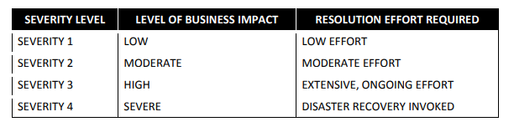
Severity Levels

Slide 49
Incident Response Process

Slide 50
Steps
Identification
Incident recording
Initial response
Communicating the incident
Containment
Formulating a incident response strategy
Incident classification
Incident investigation
Data collection
Forensic analysis
Evidence protection
Notify external agencies
Eradication
System recovery
Incident documentation
Incident damage and cost analysis
Review and update the response policies
Training awareness

Slide 51
Incident Response Process (Identification)
Obtaining and validating information related to information security issues.
Ways to conduct initial analysis for validation:
- Profile Networks and Systems
- Understand Normal Behaviours
- Create a Log Retention Policy
- Perform Event Correlation
- Keep All Host Clocks Synchronized
- Maintain and Use a Knowledge Base of Information
- Use Internet Search Engines for Research
- Run Packet Sniffers to Collect Additional Data
- Filter the Data

Slide 52
Incident Response Process (Incident recording)
Any occurrences of incident must be recorded and the incident response team should update the status of incidents along with other pertinent information.
Observations and facts of the incident may be stored in any of the following sources such as logbook, laptops, audio recorders and digital cameras etc.

Slide 53
Incident recording (Incident record template)
Current status of the incident as new, in progress, forwarded for investigation, resolved etc.
Summary of the incident
Indicators related to the incident
Other incidents related to this incident
Actions taken by all incident handlers on this incident
Chain of custody, if applicable
Impact assessments related to the incident
Contact information for other involved parties (system owners, system administrators etc.)
List of evidence gathered during the incident investigation
Comments from incident handlers
Next steps to be taken (rebuild the host, upgrade an application etc.)

Slide 54
Incident Response Process (Incident response)
Type of incident
Criticality of the resources
Data that are affected
Severity of the incident, etc.

Slide 55
Incident Response Process (Communicating the incident)
Point of Contact
Assigning and escalating information on information security incidents.

Slide 56
Incident Response Process (Containment - Quarantine)
Various containment strategies:
- Potential damage to and theft of resources
- Need for evidence preservation
- Service availability (network connectivity, services provided to external parties etc.)
- Time and resources needed to implement the strategy
- Effectiveness of the strategy (partial containment, full containment etc.)
- Duration of the solution (emergency workaround to be removed in four hours, temporary workaround to be removed in two weeks, permanent solution etc.)

Slide 57
Incident Response Process (Containment - Quarantine)
Understand network damage
Identify and isolate the trust model

Slide 58
Incident Response Process (Formulating a response strategy)
Each response strategy should be formulated based on business impact caused by the incident and the estimated efforts required to recover from the incident.

Slide 59
Incident Response Process (Incident classification)
Classifying and prioritizing information security incidents
Classified: Attack vectors
Incident prioritization
- Functional impact of the incident
- Information impact of the incident
- Recoverability from the incident

Slide 60
Incident Response Process (Incident classification)
Incident classification guidelines and templates
Requirements
Architecture and design
Implementation and development
Testing and quality assurance
System operation
Policy and standard generation

Slide 61
Incident Response Process (Incident classification)
Incident prioritization guidelines and templates
- Functional impact of the incident
- Information impact of the incident
- Recoverability from the incident

Slide 62
Incident Response Process (Incident investigation)
receive initial investigation and data gathering from IT help desk members and escalate to high strategic level specialist if situation demands.
use appropriate materials that may be needed during an investigation.
should become acquainted with various law enforcement representatives before an incident occurs to discuss conditions under which incidents should be reported to them.
maintain record of chain of custody forms should detail the transfer and include each party’s signature while transferring evidence from person to person.
should be careful to give out only appropriate information — the affected parties may request details about internal investigations that should not be revealed publicly.

Slide 63
Incident Response Process (Incident investigation) – cont.
ensure law enforcement are available to investigate incidents wherever necessary.
collect required list of evidence gathered during the incident investigation.
should collect evidence in accordance with procedures that meet all applicable laws and regulations that have been developed from previous discussions with legal staff and appropriate law enforcement agencies so that any evidence can be admissible in court.

Slide 64
Incident Response Process (Incident investigation)
Lessons learnt from security incident
- What exactly happened and during times?
- How well did staff and management perform in dealing with the incident? Were the documented procedures followed? Were they adequate?
- What information was needed sooner?
- Were any steps or actions taken that might have inhibited the recovery?
- What would the staff and management do differently the next time a similar incident occurs?

Slide 65
Incident Response Process (Incident investigation) – cont.
How could information sharing with other organizations have been improved?
What corrective actions can prevent similar incidents in the future?
What precursors or indicators should be watched for in the future to detect similar incidents?
What additional tools or resources are needed to detect, analyze and mitigate future incidents?

Slide 66
Incident Response Process (Incident investigation) – cont.
Process change for the future
Incident record keeping
systemic security weaknesses and threats, as well as changes in incident trends.
selection and implementation of additional controls.
measure the success of the incident response team.
expected return on investment from the data.

Slide 67
Incident Response Process (Data collection)
Chain of custody
Identifying information (e.g. the location, serial number, model number, hostname, media access control (MAC) addresses and IP addresses of a computer).
Name, title, and phone number of each individual who collected or handled the evidence during the investigation.
Time and date (including time zone) of each occurrence of evidence handling.
Locations where the evidence was stored.

Slide 68
Incident Response Process (Forensic analysis)
Technical areas - network intrusion detection, malware analysis or forensics.
Useful resources - digital forensic workstations and/ or backup devices to create disk images, preserve log files etc.

Slide 69
Incident Response Process (Evidence protection)
Importance of keeping evidence relating to information security incidents.

Slide 70
Incident Response Process (Notify external agencies)
to ensure that all parties know their roles and that effective line of communication are established.

Slide 71
Incident Response Process (Eradication)
Eliminating components of the incident
Identify data backup holes
spare workstations, servers, networking equipment or virtualized equivalents, which may be used for many purposes, such as restoring back-ups and trying out malware.
other important materials include back-up devices, blank media, basic networking equipment and cables.
Operating system updates and patch management
Infrastructure and security policy improvement

Slide 72
Incident Response Process (Systems recovery)
administrators restore systems to normal operation, confirm that the systems are functioning normally.

Slide 73
Incident Response Process (Incident documentation )
Importance of keeping records and evidence relating to information security incidents
Audio and video documentation strategies
Update the status of information security incidents
Possible communication methods
Email
Website
Telephone calls
In person (daily briefings)
Voice mailbox greeting
Paper

Slide 74
Incident Response Process (Incident documentation ) – contd.
Incident status template
Current status of the incident
Summary of the incident
Indicators related to the incident
Other incidents related to this incident
Actions taken by all incident handlers on this incident
Chain of custody, if applicable
Impact assessments related to the incident
Contact information for other involved parties
List of evidence gathered during the incident investigation
Comments from incident handlers
Next steps to be taken

Slide 75
Incident Response Process (Incident documentation ) – contd.
Preparing reports on information security incidents
Incident report templates
Number of incidents handled
Time per incident
Objective assessment of each incident
Subjective assessment of each incident
Submitting information security reports

Slide 76
Incident Response Process (Incident damage and cost assessment)
Organization issues a report that details the cause and cost of the incident and the steps the organization should take to prevent future incidents.

Slide 77
Incident Response Process (Review and update the response policies)
The organization must review and update response policies, related activities, gather information from the handlers, provide incident updates to other groups, and ensure that the team’s needs are met.

Slide 78
Incident Response Process (Training and awareness)
Security awareness and training checklist
Establishing an incident response training and awareness should include the following actions:
creating an incident response training and awareness policy and plan.
developing procedures for performing incident handling and reporting.
setting guidelines for communicating with outside parties regarding incidents.
training IT staff on complying with the organization’s security standards and making users aware of policies and procedures regarding appropriate use of networks, systems and applications.
training should be provided for SOP (delineation of the specific technical processes, techniques, checklists and forms) users.
staffing and training the incident response team.
providing a solid training program for new employees.
training to maintain networks, systems and applications in accordance with the organization’s security standards.
creating awareness of policies and procedures regarding appropriate use of networks, systems, and applications.

Slide 79
Incident Response Process (Training and awareness) – contd.
Incident response knowledge base
Accessing and updating knowledge base
Importance of tracking progress
Corrective and preventative actions for information security incidents

